Slide 1
Principles of programming
Algorithms

Slide 2
Contents
Algorithms
Pseudocode
Flowcharts

Slide 3
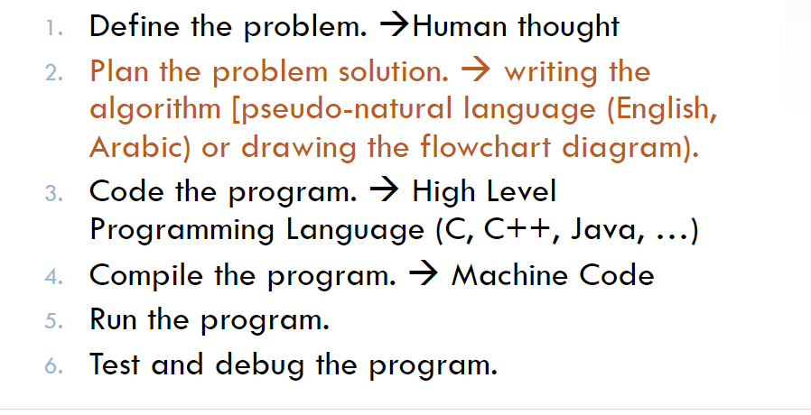
Levels of program development

Slide 4
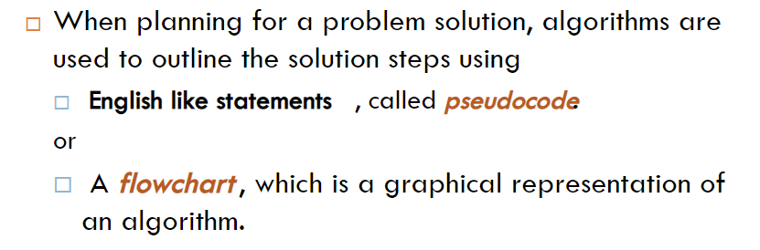
Levels of program development

Slide 5
Algorithms
A set of sequential steps usually written in Ordinary Language to solve a given problem is called Algorithm.
It may be possible to solve to problem in more than one ways, resulting in more than one algorithm.

Slide 6
Algorithms
The choice of various algorithms depends on the factors like reliability, accuracy and easy to modify.
The most important factor in the choice of algorithm is the time requirement to execute it, after writing code in High-level language with the help of a computer.
The algorithm which will need the least time when executed is considered the best.

Slide 7
Steps involved in algorithm development
An algorithm can be defined as “a complete, unambiguous, finite number of logical steps for solving a specific problem “
Step1. Identification of input:
For an algorithm, there are quantities to be supplied called input and these are fed externally.
The input is to be identified first for any specified problem.

Slide 8
Steps involved in algorithm development
Step1. Identification of input:
These are the parts/components/ingredients required to accomplish the task

Slide 9
Steps involved in algorithm development
Step2: Identification of output:
From an algorithm, at least one quantity is produced, called for any specified problem.
Step3 : Identification the processing operations :
All the calculations to be performed in order to lead to output from the input are to be identified in an orderly manner.

Slide 10
Steps involved in algorithm development
Algorithms for making things will often be divided into sections;
– the parts/components/ingredients (inputs) required to accomplish the task
– actions/steps/methods (processing) to produce the required outcome (output).
For example to build a model car, the parts (inputs) are needed plus instructions on how to assemble the car (processing) and the result is the car (output).

Slide 11
IPO CHART

Slide 12
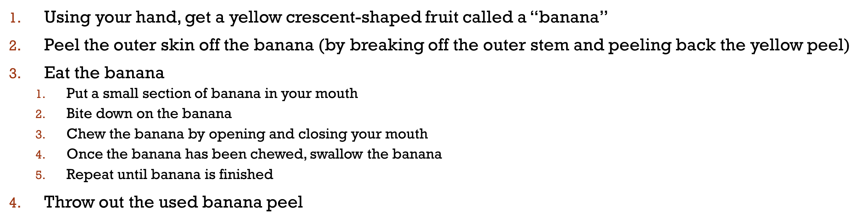
EXAMPLE (HOW TO EAT A BANANA)

Slide 13
Algorithms
Two forms of Algorithm:
– Pseudocode
– Flow chart

Slide 14
Pseudocode
An algorithm can be written in English like sentences or in any standard representation sometimes, algorithm written in English like languages are called Pseudo Code
Pseudocode (which means fake code, because its not really programming code) specifies the steps required to accomplish the task.
Pseudocode is a type of structured English that is used to specify an algorithm.

Slide 15
Pseudocode
Pseudocode cannot be compiled nor executed, and there are no real formatting or syntax rules.
In pseudo code, the program is represented in terms of words and phrases, but the syntax of program is not strictly followed.

Slide 16
Why is Pseudocode Necessary?
The programming process is a complicated one.
You must first understand the program specifications.
Then you need to organize your thoughts and create the program.
You must break the main tasks that must be accomplished into smaller ones in order to be able to eventually write fully developed code.
Writing Pseudocode will save you time later during the construction & testing phase of a program's development.

Slide 17
How to Write Pseudocode Statements?
There are six basic computer operations
A computer can receive information Read (information from a file), Get (information from the keyboard)
A computer can put out information Write (information to a file), Display (information to the screen)

Slide 18
How to Write Pseudocode Statements?
There are six basic computer operations
A computer can perform arithmetic Use actual mathematical symbols or the words for the symbols Example:
Add number to total
Total = total + number
+, -, *, / Calculate, Compute also be used

Slide 19
How to Write Pseudocode Statements?
There are six basic computer operations
A computer can assign a value to a piece of data
- to give data an initial value Initialize, Set
-to assign a value as a result of some processing
x = 5+y
- to keep a piece of information for later use Save, Store

Slide 20
How to Write Pseudocode Statements?
There are six basic computer operations
A computer can compare two piece of information and select one of two alternative actions
IF condition THEN
some action
ELSE alternative action
ENDIF

Slide 21
How to Write Pseudocode Statements?
There are six basic computer operations
A computer can repeat a group of actions
WHILE condition (is true)
some action
END WHILE

Slide 22
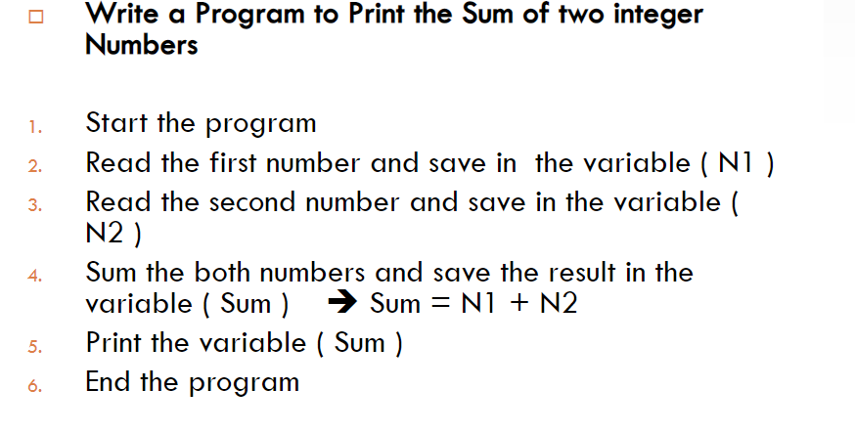
Example

Slide 23
Example
Write a program that obtains two integer numbers from the user. It will print out the sum of those numbers.
Prompt the user to enter the first integer
Prompt the user to enter a second integer
Compute the sum of the two user inputs
Store the answer as sum
Display the result

Slide 24
Example 1(Pseucocode)
Finding average of any three numbers
Step 1: Start
Step 2: Read values of X, Y, Z
Step 3: S = X + Y + Z
Step 4: A = S / 3
Step 5: Write value of A
Step 6: Stop

Slide 25
Example 2(pseudocode)
Finding square and cube.
Step 1: Start
Step 2: Read value of N
Step 3: S = N * N
Step 4: C = S * N
Step 5: Write values of S, C
Step 6: Stop

Slide 26
Example 3(pseudocode)
Finding biggest of two numbers.
Step 1: Start
Step 2: Read A, B
Step 3: If A > B, then BIG = A, otherwise BIG = B
Step 4: Write BIG
Step 5: Stop

Slide 27
Example 4(pseudocode)
Calculate pay.
Step 1: Start
Step 2: Input hours
Step 3: Input rate
Step 4: pay = hours * rate
Step 5: Print pay
Step 6: End

Slide 28
Flowchart
A flowchart is a graphical representation of an algorithm.
These flowcharts play a vital role in the programming of a problem and are quite helpful in understanding the logic of complicated and lengthy problems.
Once the flowchart is drawn, it becomes easy to write the program in any high level language.

Slide 29
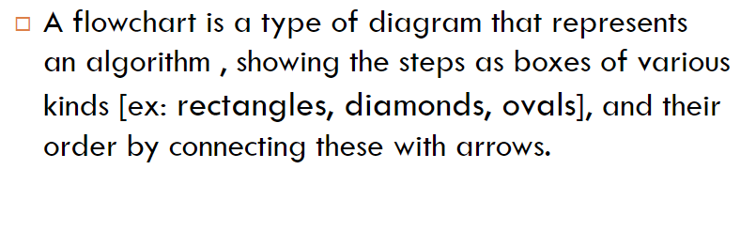
Flowchart

Slide 30
Flowchart
A flowchart can therefore be used to:
– Define and analyze processes
– Build a step-by-step picture of the process for analysis, discussion, or communication
– Define, standardize or find areas for improvement in a process

Slide 31

Flowchart Symbols
Start and end symbols
Represented as ovals or rounded rectangles
Usually containing the word “Star:” or “End”, or another phrase signaling the start or end of a process, such as “submit enquiry” or “receive product”.

Slide 32
Flowchart Symbols
Arrows
Showing what's called "flow of control" in computer science.
An arrow coming from one symbol and ending at another symbol.
Represents that control passes to the symbol the arrow points to

Slide 33
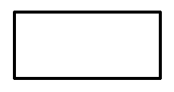
Flowchart Symbols
Processing steps
Represented as rectangles.
Examples: “Add 1 to X"; "replace identified part"; "save changes" or similar.

Slide 34
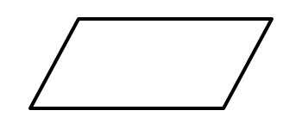
Flowchart Symbols
Input/output
Represented as a parallelogram.
Examples: Get X from the user; display X.

Slide 35
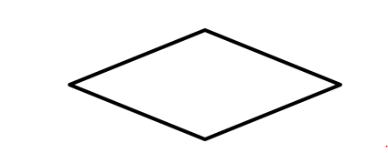
Flowchart Symbols
Conditional or decision
Represented as a diamond (rhombus).
These typically contain a Yes/No question or True/False test

Slide 36
Advantages of Using Flowcharts
Communication: Flowcharts are better way of communicating the logic of a system to all concerned.
Effective analysis: With the help of flowchart, problem can be analyzed in more effective way.
Proper documentation: Program flowcharts serve as a good program documentation, which is needed for various purposes.
Efficient Coding: The flowcharts act as a guide or blueprint during the systems analysis and program development phase.

Slide 37
Advantages of Using Flowcharts
Proper Debugging: The flowchart helps in debugging process.
Efficient Program Maintenance: The maintenance of operating program becomes easy with the help of flowchart. It helps the programmer to put efforts more efficiently on that part.

Slide 38
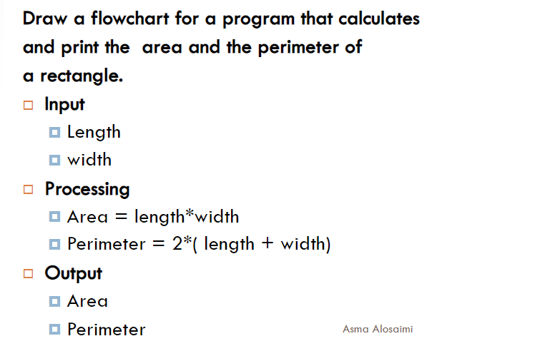
Example

Slide 39
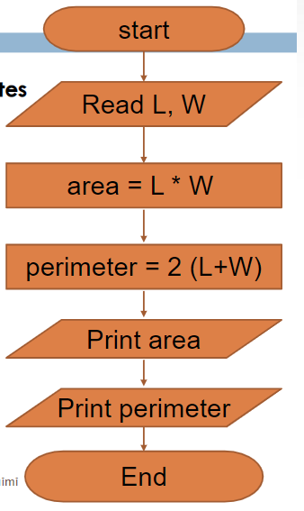

Slide 40
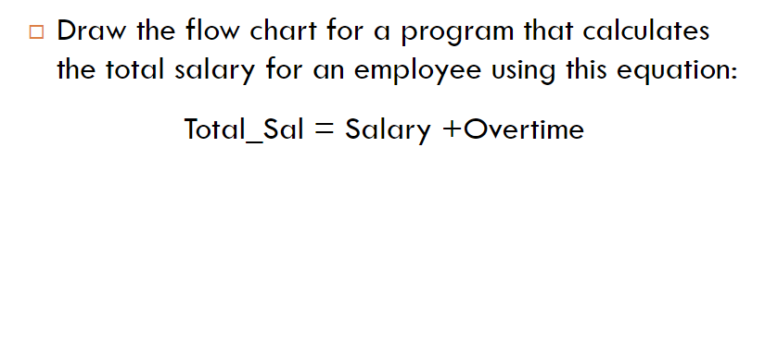
Example

Slide 41
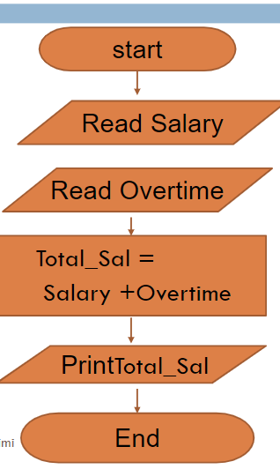
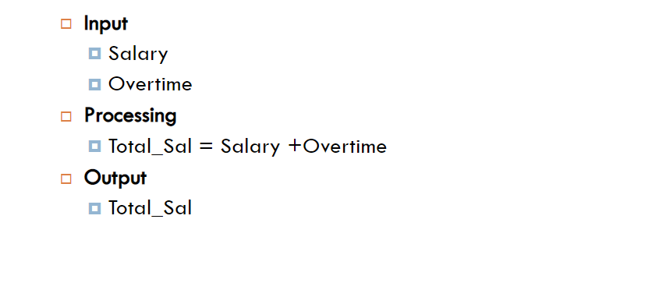
Solution

Slide 42
example 1
Algorithm:
Input: two numbers x and y
Output: the average of x and y
Steps:
1. input x
2. input y
3. sum = x + y
4. average = sum /2
5. output average

Slide 43
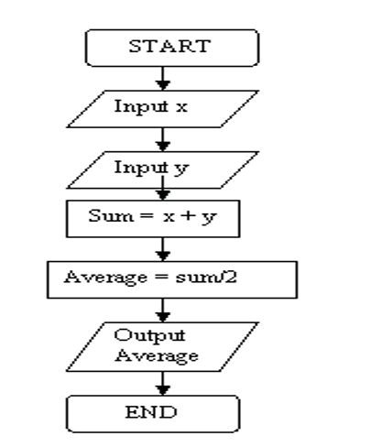
Flow chart

Slide 44
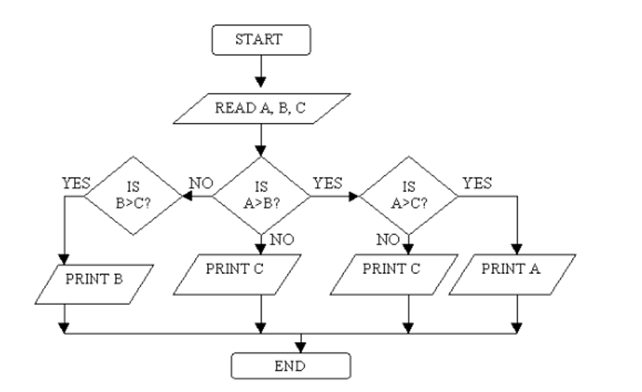
Example 2
Draw a flowchart to find the
largest of three
numbers A, B, and C.

Slide 45
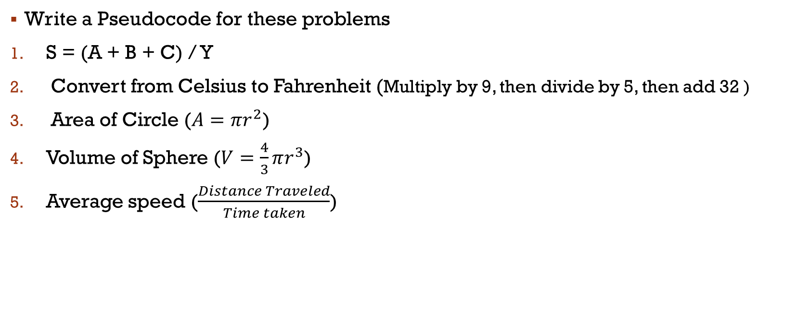
Exercise
Write a Pseudocode for these problems
S = (A + B + C) / Y
Convert from Celsius to Fahrenheit (Multiply by 9, then divide by 5, then add 32 )
Area of Circle ($A=πr^{2}$)
Volume of Sphere ($V=\frac{4}{3}πr^{3}$)
Average speed ($\frac{Distance Traveled}{Time taken}$)

Slide 46
end

